Slide 1

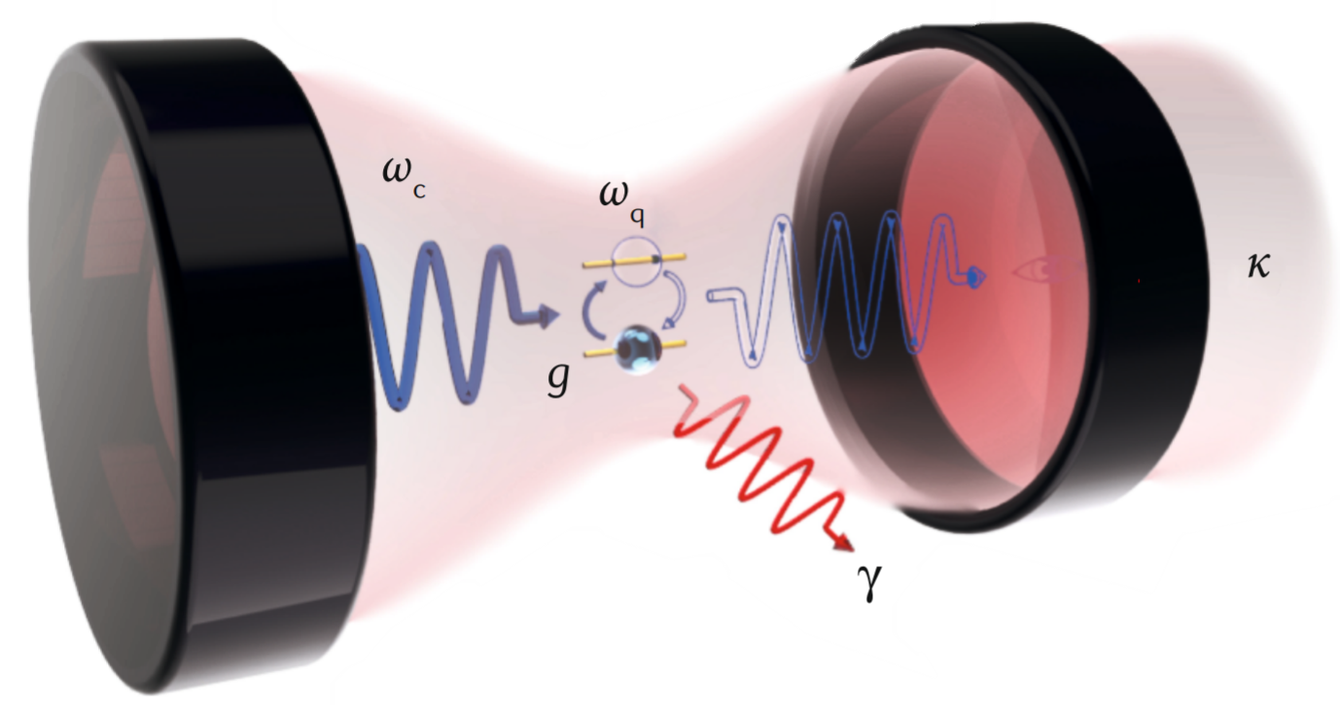
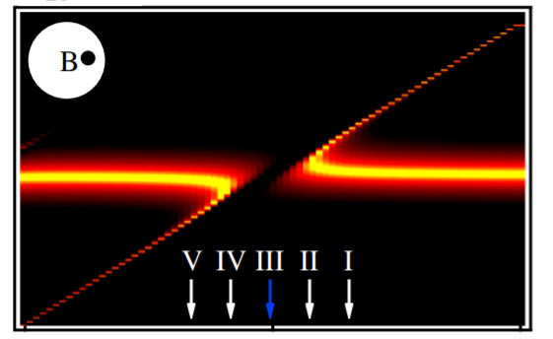
Exploring the applications of dissipative coupling in microwave frequencies
Kockum A F, et al. Nature Reviews Physics, 2019, 1(1): 19-40.
Yutong Zhao
Department of Physics and Astronomy
University of Manitoba
Program: Master of Science
Supervisor: Dr. Can-Ming Hu
Committee: Dr. Gregory Bridges
Dr. Jacob Burgess
Harder, M., et al. Physical review letters 121.13 (2018): 137203.

Slide 2


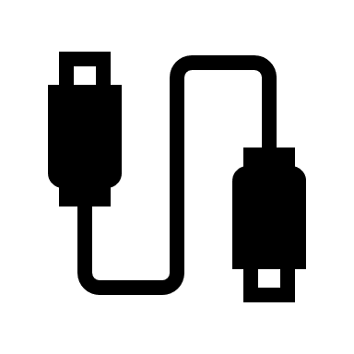

Table of Content
Exploring the applications of dissipative coupling in microwave frequencies
Academic progress overview
Introduction to dissipative coupling
Theoretical background
Dissipative coupling in Metamaterials
Broadband nonreciprocal device
Conclusion
Notes:
This presentation will be divided into six parts.
Firstly, there is a quick review with my academic progress.
The second would be the introduction to the dissipative coupling and cavity magnon polariton, which basically the foundation of my thesis research.
The third part is the theoretical description on the dissipative coupling in cavity magnon polaritons.
Next is the dissipative coupling in metamaterial structures.
Then I will talk about the broadband nonreciprocal device and how we realize it.
Finally, I will summarize the key point of this thesis research works and propose some future work.

Slide 3
Research and academic progress
Course Work:
Course Work:
PHYS 7510
Condensed Matter Physics 2 (A)
PHYS 7590
Electromagnetic Theory (A+)
ECE 7440
Microwave Materials Measurement Techniques (A+)
Course Work:
PHYS 7720
Quantum Mechanics 1 (A+)
2020
2019
2018
2020.06 2nd Progress meeting + Thesis submission
2020.07 Published 1st paper
2020.08 Thesis defense + Finial submission
2019.04 1st Progress meeting
+ Thesis proposal
2018.09 Start of the program
Publications
First authored
[1]. Zhao, Y. T., et al. "Broadband nonreciprocity realized by locally controlling the magnon’s radiation." Physical Review Applied, 2020, 14(1): 014035.
[2]. Rao, J. W., et al. "Analogue of dynamic Hall effect in cavity magnon polariton system and coherently controlled logic device." Nature communications 10.1 (2019): 1-7.
[3]. Yao, B.M., et al. "Coherent control of magnon radiative damping with local photon states", Communications Physics (2019):0482
[4]. Rao, J. W., et al. "Level attraction and level repulsion of magnon coupled with a cavity anti-resonance." New Journal of Physics 21.6 (2019): 065001.
Co-authored
Notes:
As a review, I started my program in 2018, and did my first progress meeting and thesis proposal in last year. This year I did the 2nd progress meeting and prepare to graduate.
I have taken 4 courses in total and got three A+ and one A.
I have published 1 first authored paper and three other co-authored papers.
That is my brief review of my academic progress.

Slide 4
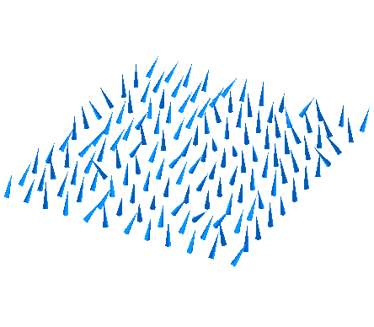
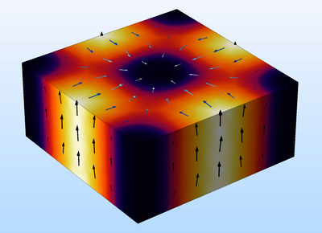

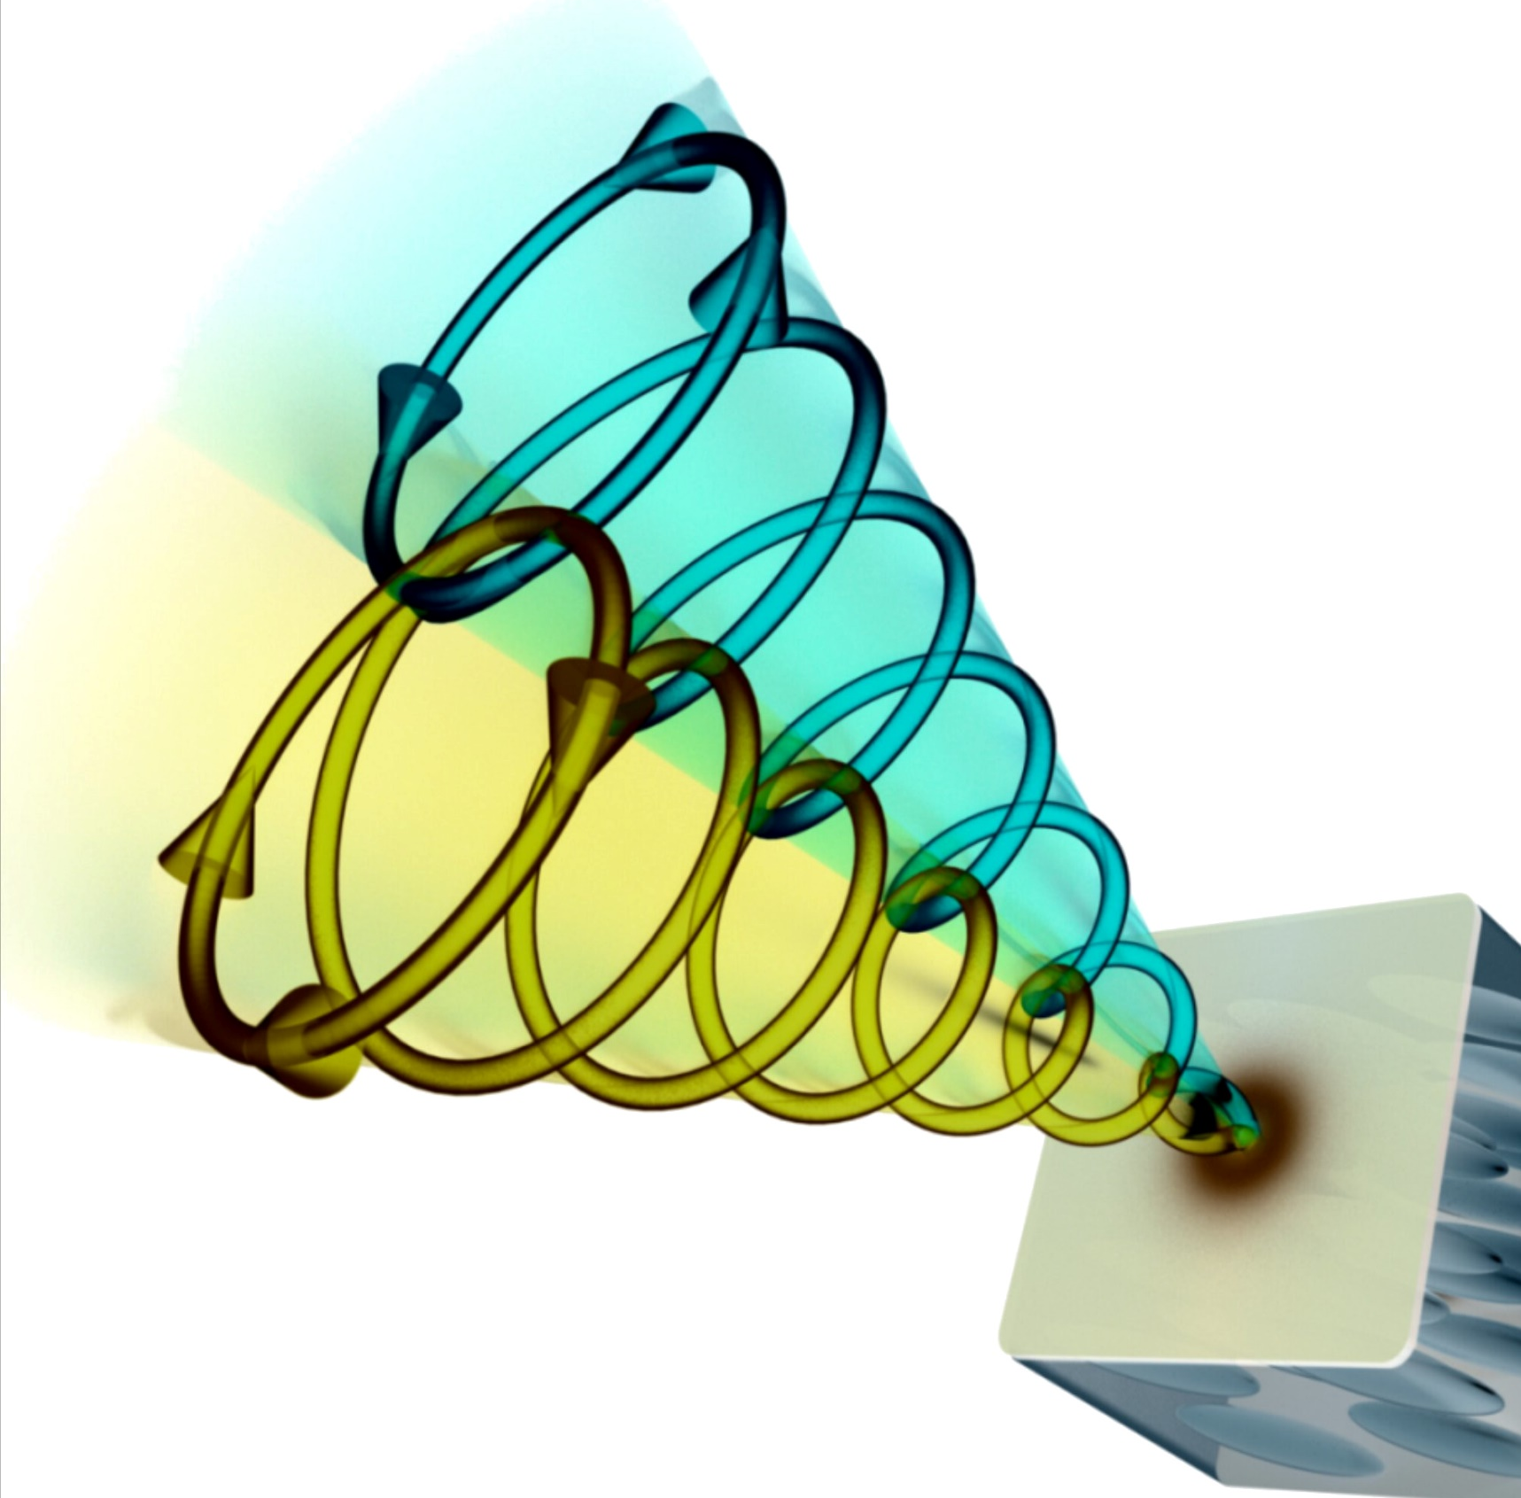

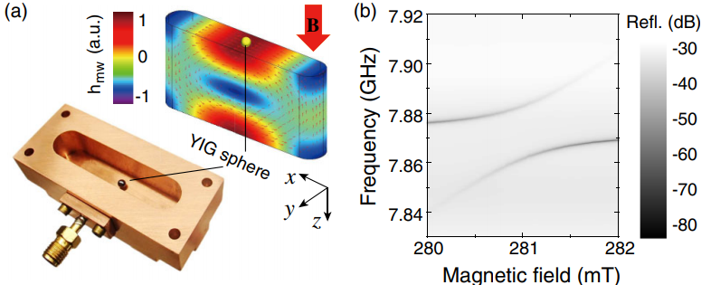
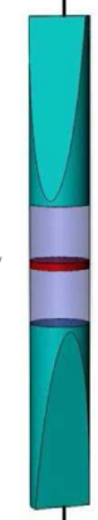
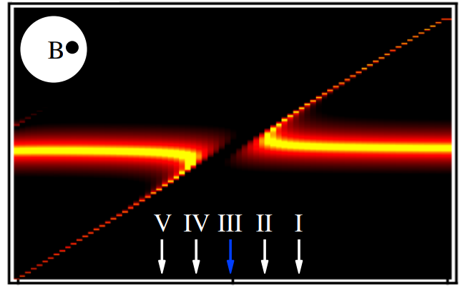
Introduction to cavity-magnon-polariton (CMP)
Cavity photon
Spin wave (magnon)
CMP
Coupling Mechanics of CMP
Coherent coupling
Dissipative coupling
Physical review letters
121.13 (2018): 137203.
Physical review letters 113.15 (2014): 156401.
Discovery of level attraction in CMP
Level repulsion has been widely studied in CMP
My research is focused on dissipative coupling.
Notes:
Now we need to introduce the background of my research.
Firstly, the cavity magnon polariton is generated from strong interaction between the electromagnetic wave in a cavity and the spin waves. This is also known as strong coupling and the generation of polariton is known as a quasi-particle because this particle have the magnon-photon duality.
There are two coupling mechanism that currently known, one is coherent coupling which gives avoided-crossing behavior for the coupled modes. This is known as the level repulsion and have been intensively studied in the past decades.
Another one is the dissipative coupling, which has been discovered 2 years ago and preserve a different pattern in the dispersion. The two coupled modes attract each other and this is known as the level attraction.
My research work is concentrated on this newly discovered coupling regime and explore its application in microwave frequencies.

Slide 5
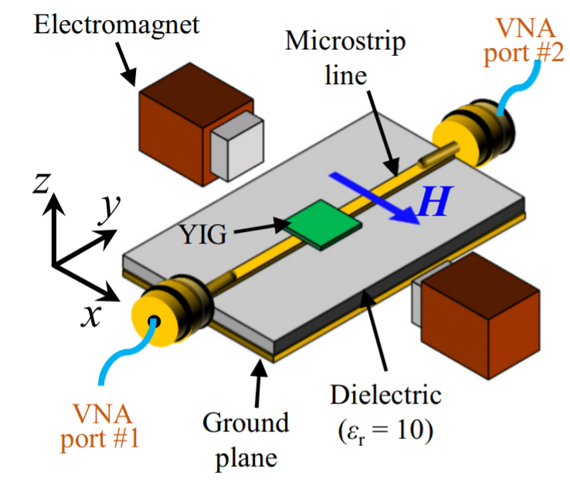
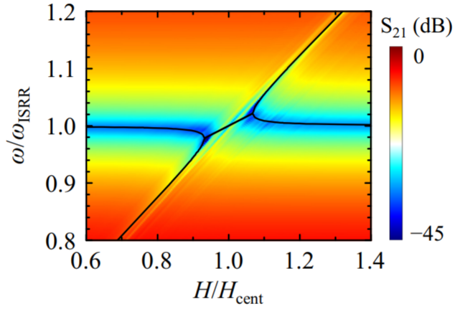
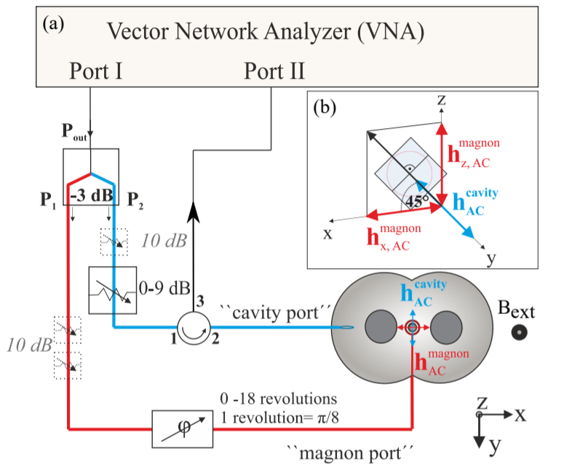
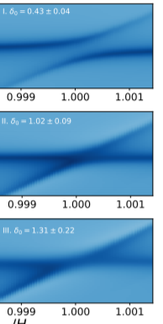
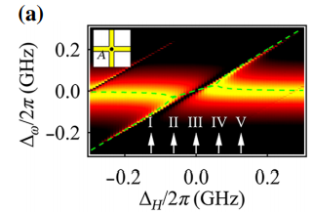
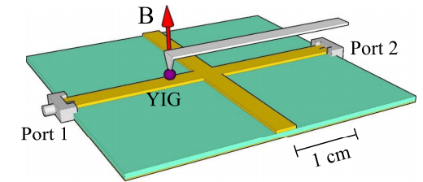
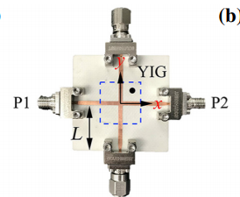
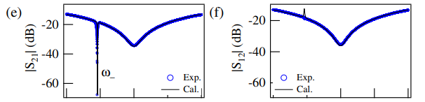
What we can make use of dissipative coupling?
Physical Review B 99.13 (2019): 134426.
Physical Review Research 2.1 (2020): 013154.
On-chip level attraction with planar YIG
Linewidth control use level merging
On-chip device utilizing level attraction
Nonreciprocal microwave transmission
Physical Review Applied 11.5 (2019): 054023.
Physical review letters 123.12 (2019): 127202.
Notes:
So here comes the question, what can we make use of dissipative coupling?
Firstly, the level attraction has been discovered in various system and different designs. This work shows research group independently discovered the level attraction.
This confirms the level attraction is general existed in nature and it can be realized in many different way.
Soon after, the level attraction on a planar structure was realized in a different way. This two works are a great advance towards on-chip device.
Also, the dissipative coupling used to control the linewidth of the.
And the nonreciprocal transmission was observed. And have the ability of designing new isolators for microwave components.
Based on these previous discovery, there are still a lots of applications of dissipative coupling waiting to be explored. Therefore, in this thesis work, we are about to discover more about the application in dissipative coupling.

Slide 6
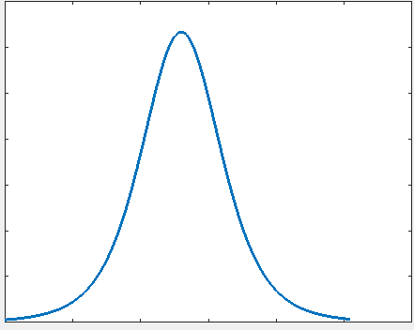
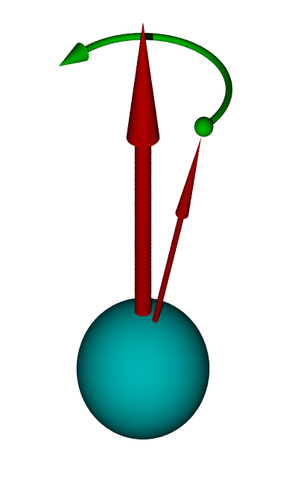
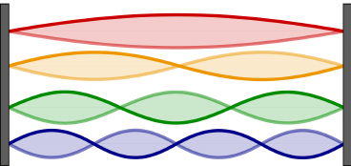
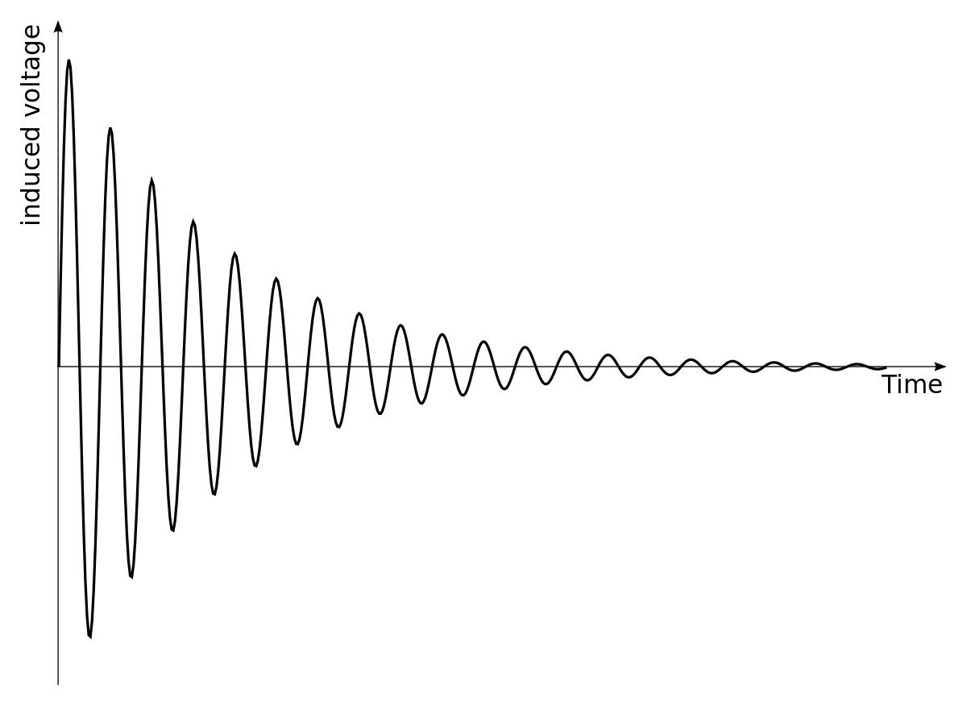
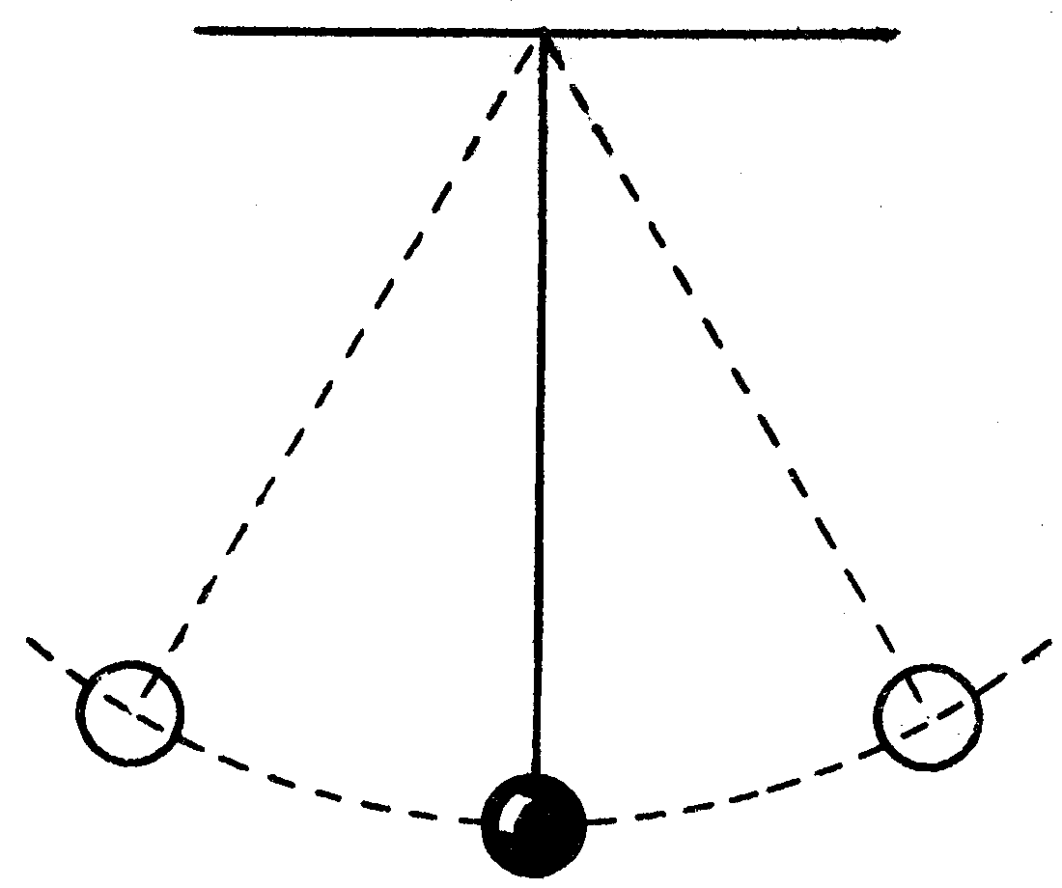
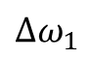
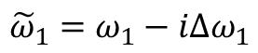
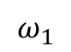

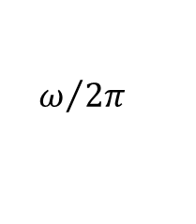
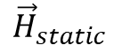
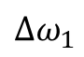
How do we understand CMP?
Frequency response
Coupled photon and magnon
$${\vec{H}}_{static}$$
Standing wave
Precession
Amplitude
Linewidth
$$\vec{M}$$
$$Δω_{1}$$
$$ω_{1}$$
$$ω/{2π}$$
Ferromagnetic resonance
Photon cavity resonance
Time-domain response
→ Periodic motion
Complex frequency
$$Δω_{1}$$
Amplitude
Damping
$${\tilde{ω}}_{1}=ω_{1}−iΔω_{1}$$
Resonance (real) + damping (imaginary)
time
Simplified to Pendulum
Notes:
Knowing the applications of cavity magnon polaritons. Now we need to understand how this works and how do we model this system.
The magnon in principle is magnetization process along an external static magnetic field, that produced a periodic motion and strongly absorb electromagnetic wave with certain frequency. The photon cavity resonance generated by the electromagnetic wave reflected on the wall of cavity, bouncing back and forth and formed a standing wave.
Both magnon and cavity photon can be simplified to periodic motions such as a pendulum, with a complex frequency to describe its behavior.
One is the real part, which gives the resonant frequency, and the imaginary part, that gives the damping of the resonance.
For a single resonance, In the frequency domain, we would get a Lorentzian line shape with the maximum give real part and the linewitdth characterize the imaginary part.
In the time domain, the imaginary part determines the exponential decay rate of the amplitude.

Slide 7
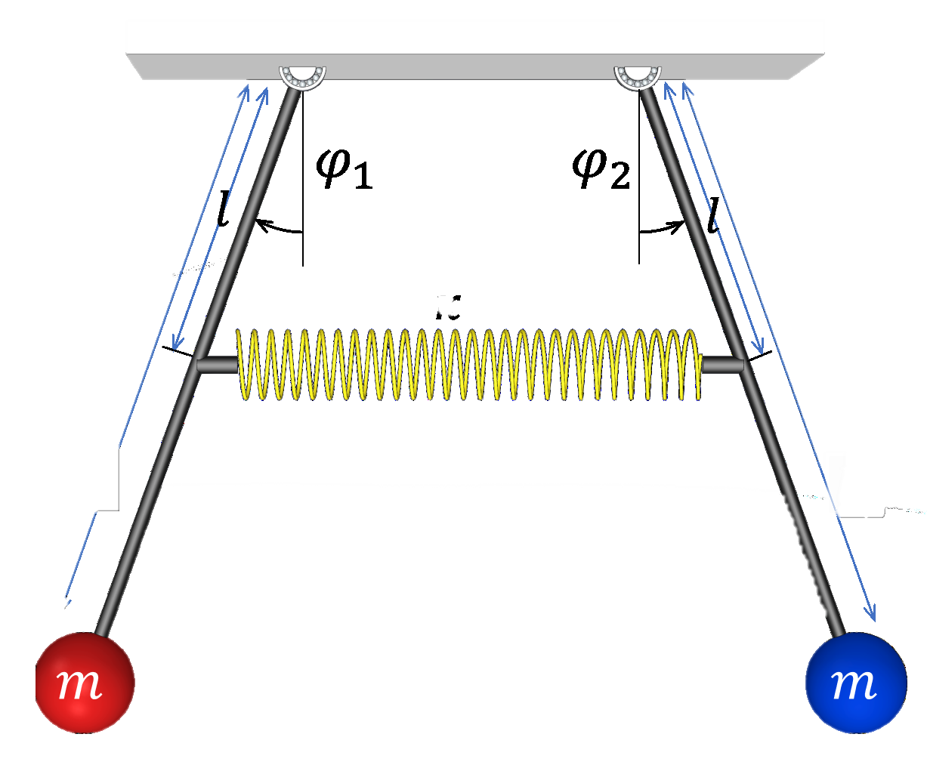
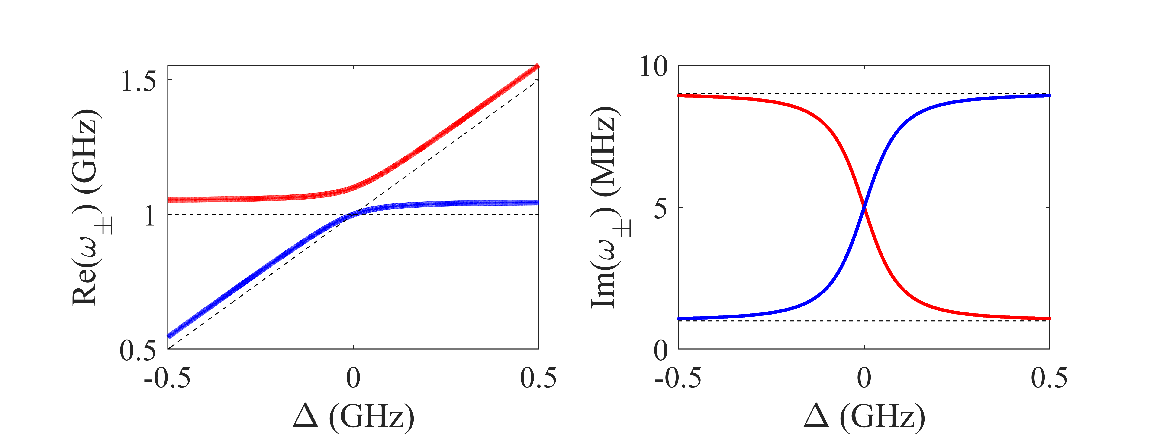
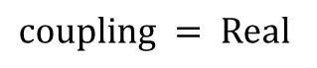
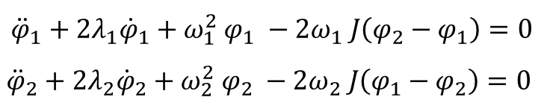
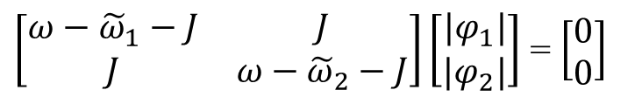
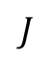
Coherent coupled pendulums
Schematic – Spring
Equation of motion:
$${\ddot{φ}}_{1}+2λ_{1}{\dot{φ}}_{1}+ω_{1}^{2} φ_{1} −2ω_{1} J\left(φ_{2}−φ_{1}\right)=0$$
$${\ddot{φ}}_{2}+2λ_{2}{\dot{φ}}_{2}+ω_{2}^{2} φ_{2} −2ω_{2} J\left(φ_{1}−φ_{2}\right)=0$$
$$J$$
Matrix form
$\left[\begin{matrix}ω−{\tilde{ω}}_{1}−J & J \\ J & ω−{\tilde{ω}}_{2}−J\end{matrix}\right]\left[\begin{matrix}|φ_{1}| \\ |φ_{2}|\end{matrix}\right]$ = $\left[\begin{matrix}0 \\ 0\end{matrix}\right]$
$coupling = Real$
→ Conservative force
→ Level repulsion
→ Linewidth exchange
Notes:
Now we introduce the coherent coupling by using spring coupled pendulums.
The equation of motion can be obtained by using the Newton’s second law, if we translate this equations into matrix form, we will get the form shown on the middle part of the screen. The diagonal terms gives the pendulum 1 and pendulum 2, and the off-diagonal terms determines the coupling.
In this case the coupling term is given by a real value which corresponds to a conservative force, this is consistent with the property of a spring force. If we solve the eigenfrequencies of the matrix, we have the coupled modes display the level repulsion dispersion and the they exchanged damping with each other during the coupling.

Slide 8
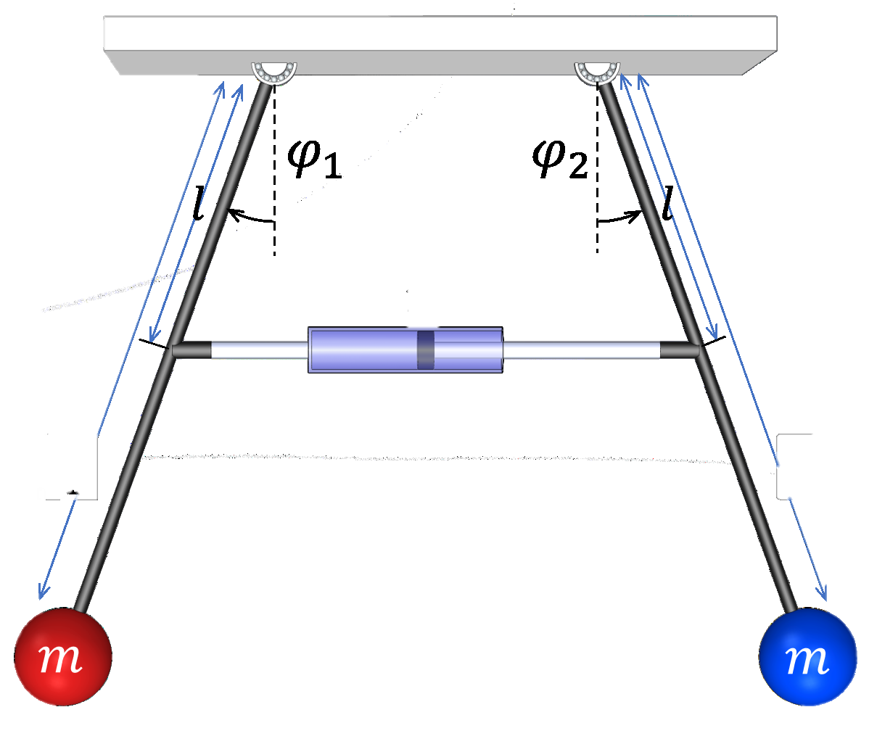
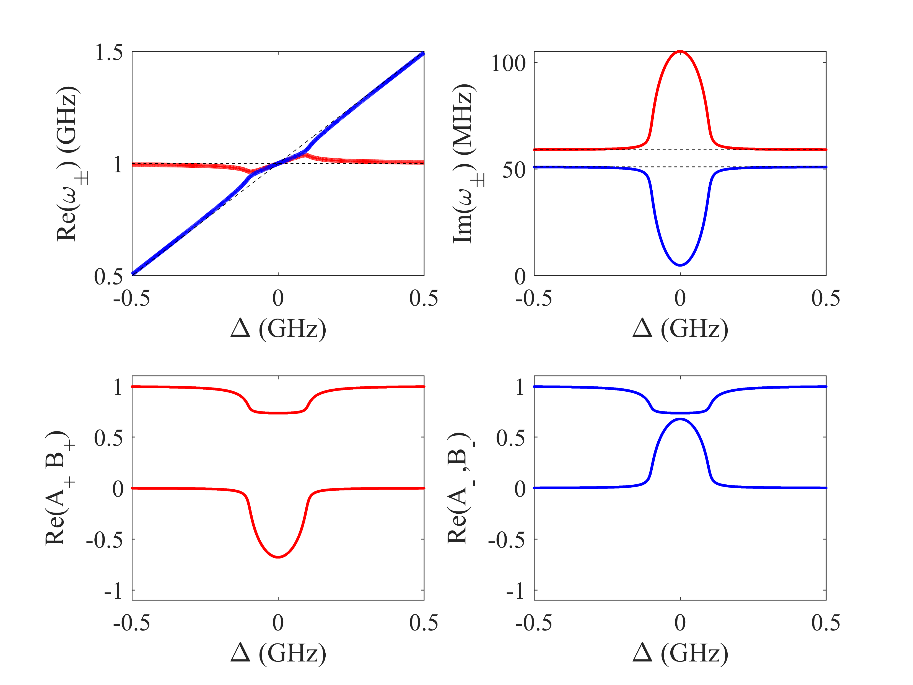
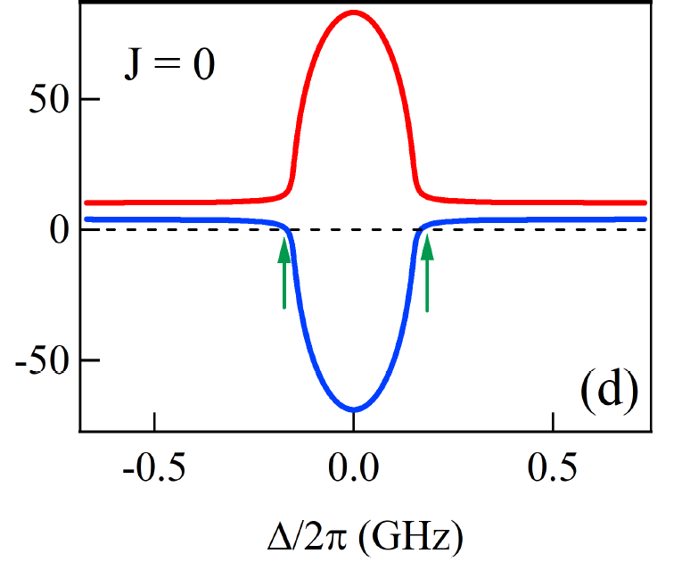
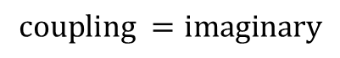
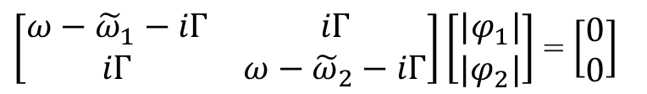
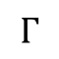
Dissipative coupled pendulums
Schematic – Dashpot
Matrix form
$\left[\begin{matrix}ω−{\tilde{ω}}_{1}−iΓ & iΓ \\ iΓ & ω−{\tilde{ω}}_{2}−iΓ\end{matrix}\right]\left[\begin{matrix}|φ_{1}| \\ |φ_{2}|\end{matrix}\right]$ = $\left[\begin{matrix}0 \\ 0\end{matrix}\right]$
$$Γ$$
$$coupling =imaginary$$
→ Nonconservative force
Mechanical systems
Polariton systems
Green arrow → zero damping
Shade area → negative damping
→ Level attraction
→ Linewidth “repulsion”
Notes:
For dissipative coupling, the pendulum remain same, but the coupling component has been changed to a damper or dashpot. This mechanical component provide a force that is proportional to the velocity of the relative motion.
So we write down the equation of motion and the matrix form. This time the coupling term become imaginary which means the coupling force and a nonconservative force. And this is equivalent to a friction force that dissipate the energy.
The dispersion gives the attractive behavior between the two coupled modes and this is why we name this phenomenon as level attraction. The damping rate would repel each other and push them to an area that coherent coupling would never reach.
By using this property, we can achieve a relatively small, even zero or negative damping.

Slide 9
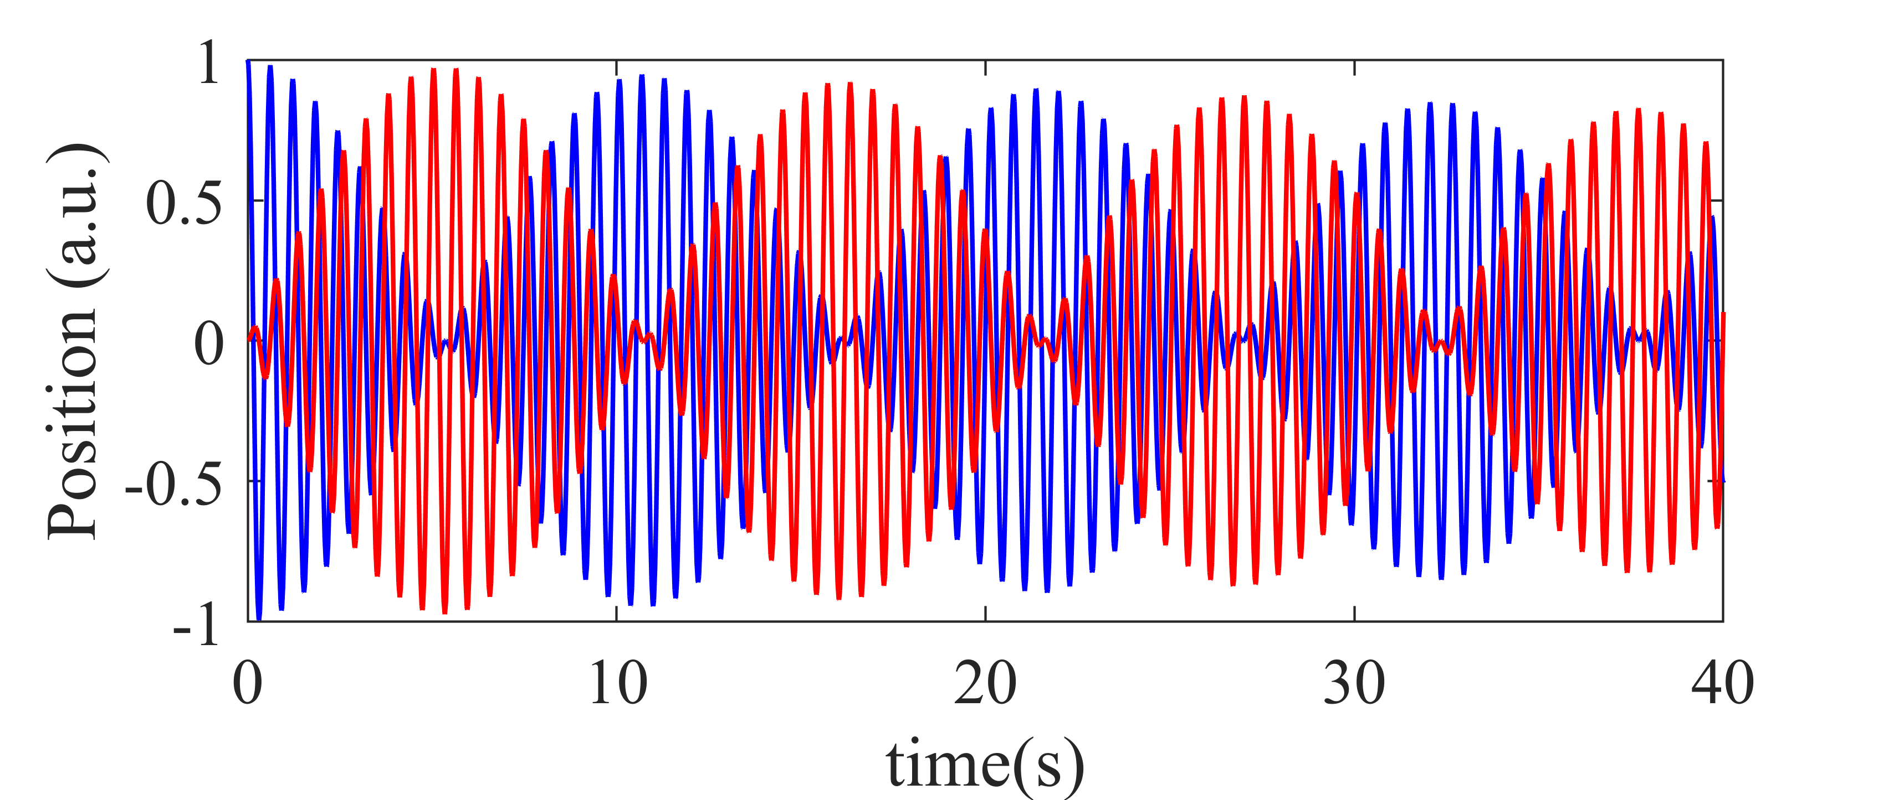
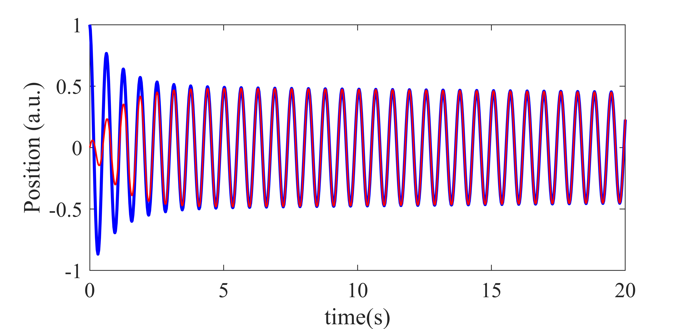
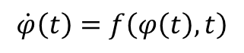
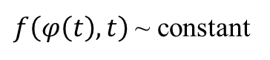
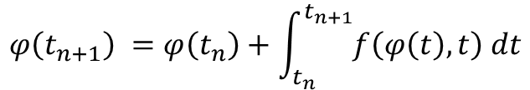
Numerical methods for time domain analysis
Coherent coupling - Rabi Oscillation like
Equation of motion:
$$\dot{φ}\left(t\right)=f\left(φ\left(t\right),t\right)$$
→ Ordinary Differential Equations (ODEs)
Next moment
This moment (initial conditions)
Dissipative coupling - Synchronization like
$$φ\left(t_{n+1}\right) =φ\left(t_{n}\right)+\int_{t_{n}}^{t_{n+1}}{f\left(φ\left(t\right),t\right) dt}$$
Numerical approximation
$f\left(φ\left(t\right),t\right)$~ constant
$$φ\left(t_{n+1}\right) =φ\left(t_{n}\right)+f\left(φ\left(t\right),t\right)\left(t_{n+1}−t_{n}\right)$$
Notes:
Since we have the equation of motion for the coupling oscillators. We can reorganize the form of the equation of motions into the differential forms. By doing this, we can get a set of differential equations as a function of time, and the current states of the system. These are known as ordinary differential equations.
If we perform a simple integral on these ODEs, we can get the states of the system of next moment by using the information of this moment. The interval between this two moment is known as step-size. If we set the step-size very tiny, the term in the integral can be approximated by using a constant. As this method is known as numerical method.
We can derive the time-domain signal by using this method.
For example, if the two oscillator matches its frequency, the coherent coupling would produce a beating pattern one by one. The envelope of the beating is known as the Rabi Oscillation and this phenomena has been intensively studied in the a few past decades.
The dissipative coupling shows the slower oscillator would chase the faster oscillator; the velocity difference will be quickly eliminated by the coupling process. And eventually the system will reach to a synchronization like motion.
Here is the theoretical background of dissipative coupling.

Slide 10
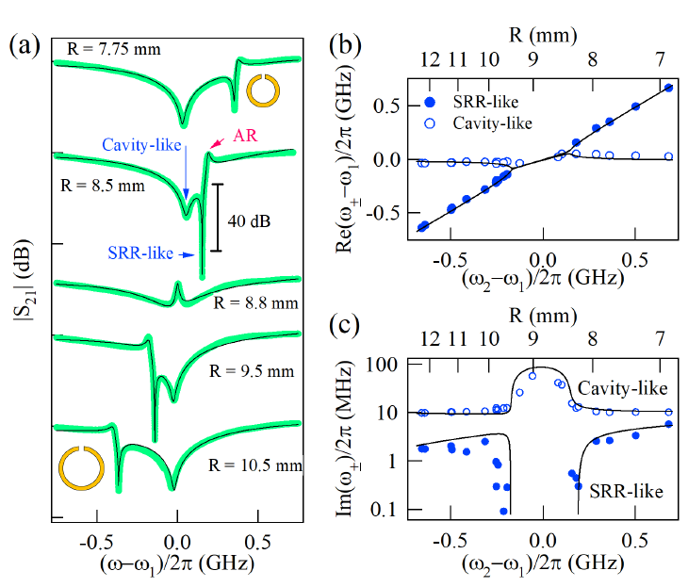
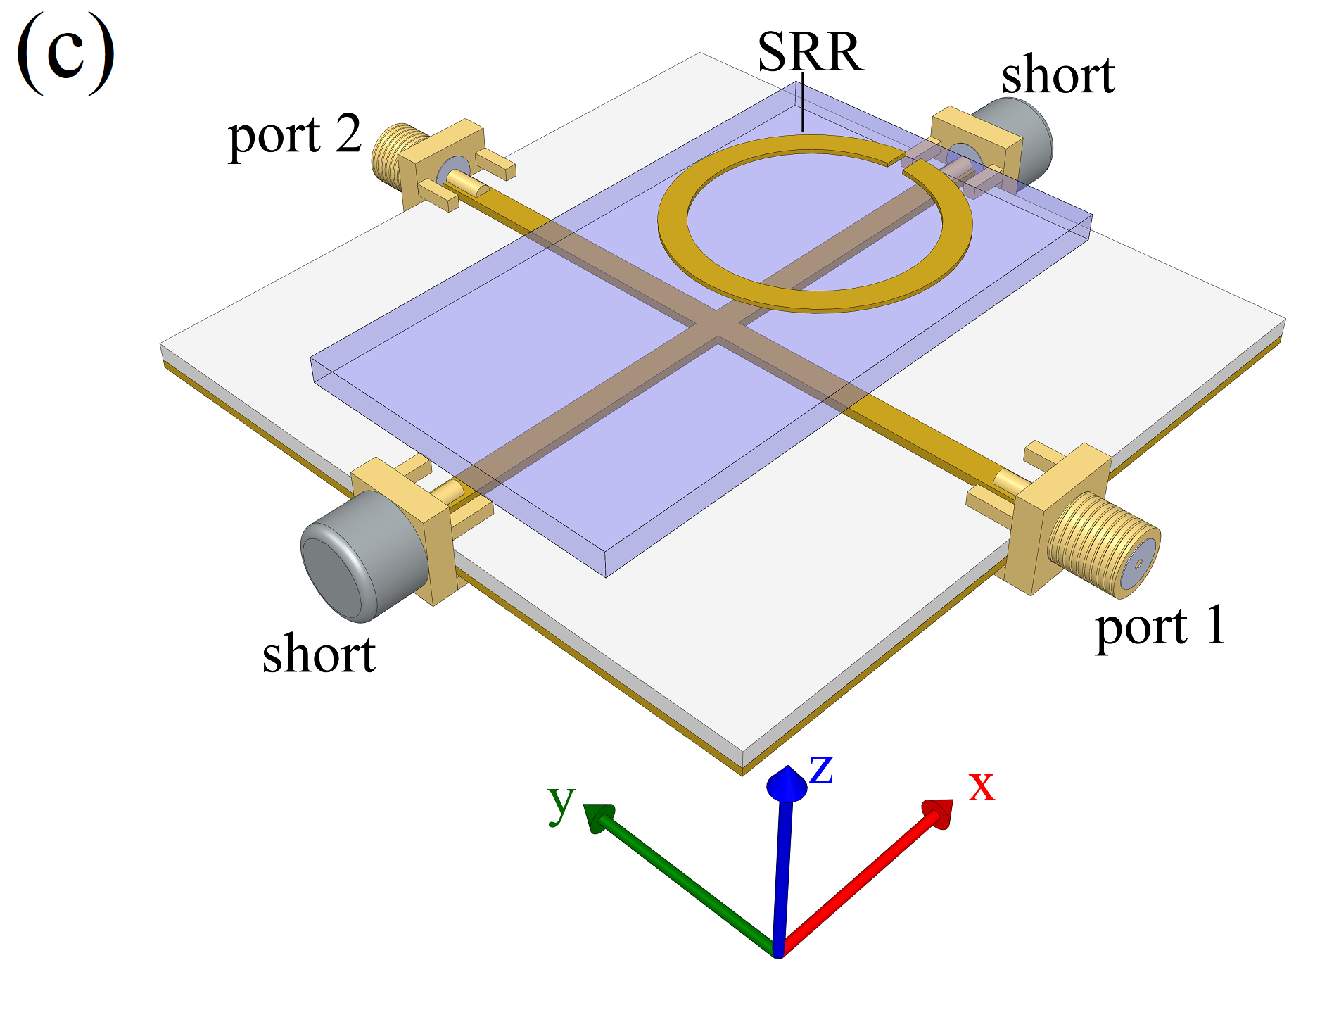
Dissipative coupling in metamaterials
Level attraction
Linewidth
Narrowing
Experiment design
Measured Spectra
Dispersion
Notes:
Now we introduce our first experimental work, we have used a split-ring resonator and the cross-shaped microstrip cavity to realize the dissipative coupling.
As the experiment setup shows, we placed the split ring resonator above the cross cavity, and measure the transmission of the system.
As we change the size of the split-ring, we are able to tune the resonant frequency.
The spectra was shown in figure (a) for different split-rings. As you can see from the curves, we can observe the cavity-like hybridized mode and split-ring-resonator like modes from the figure.
If we read the hybridized mode frequency, we can get the level attraction in dispersion shown in figure (b), this corresponds to the real part of the eigenvalue we calculated from theory.
Also, if we fit the linewidth of the modes, we would get the linewidth in figure (c), and this corresponds to the imaginary of the linewidth.
Notice the linewidth are shown in log scale, one of the properties in dissipative coupling is zero-damping.
We are about to utilize this property and propose practical applications for microwave devices.

Slide 11
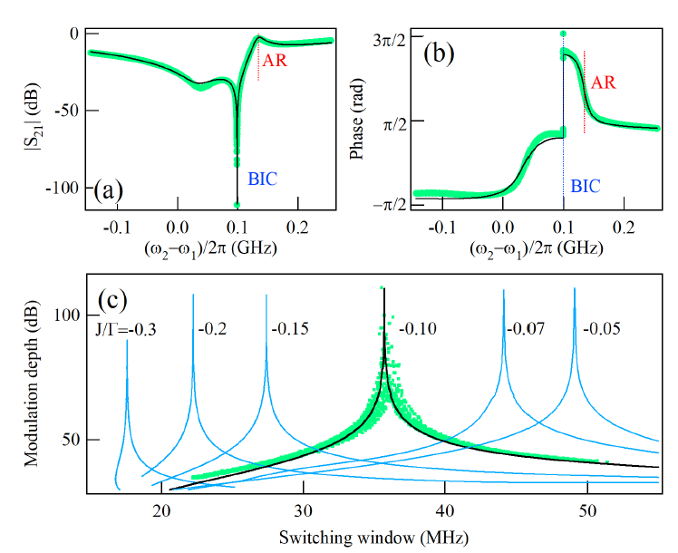
Transmission transition from 0 to 1
Asymmetry resonance is a typical Fano resonance
We have observed a transition from 0 to 1 in transmission.
1 → on
0 → off
Potential to design switching device.
Smaller window → high performance
ZDC
ZDC
Notes:
Figure (a) shows a typical spectrum measured near the zero-damping condition, the spectrum is given by (a) shows a asymmetry behavior. This asymmetry transmission can be interpreted as Fano resonance.
The measured phase is shown in figure (b).
From the transmission, we can know the zero-damping condition is very close to the antiresonance. Where the antiresonance is related to the bare frequency of the split-ring resonator.
Our system have demonstrated the transmission from complete distinction zero to complete transmission one in a relative narrow window.
If we take the zero transmission corresponds to “off”, and transmission “1” is “on”. The narrow window bring us the potential to quickly shift from 0 to 1 or 0 to 1, which makes this device as a microwave switch.
According to our theory, the switching window could be optimized by control the coupling strength. A smaller switching window would improve the performance of the switch and makes it more practical in applications.
Therefore, our device can be used to design high-quality switching device in microwave frequencies.

Slide 12
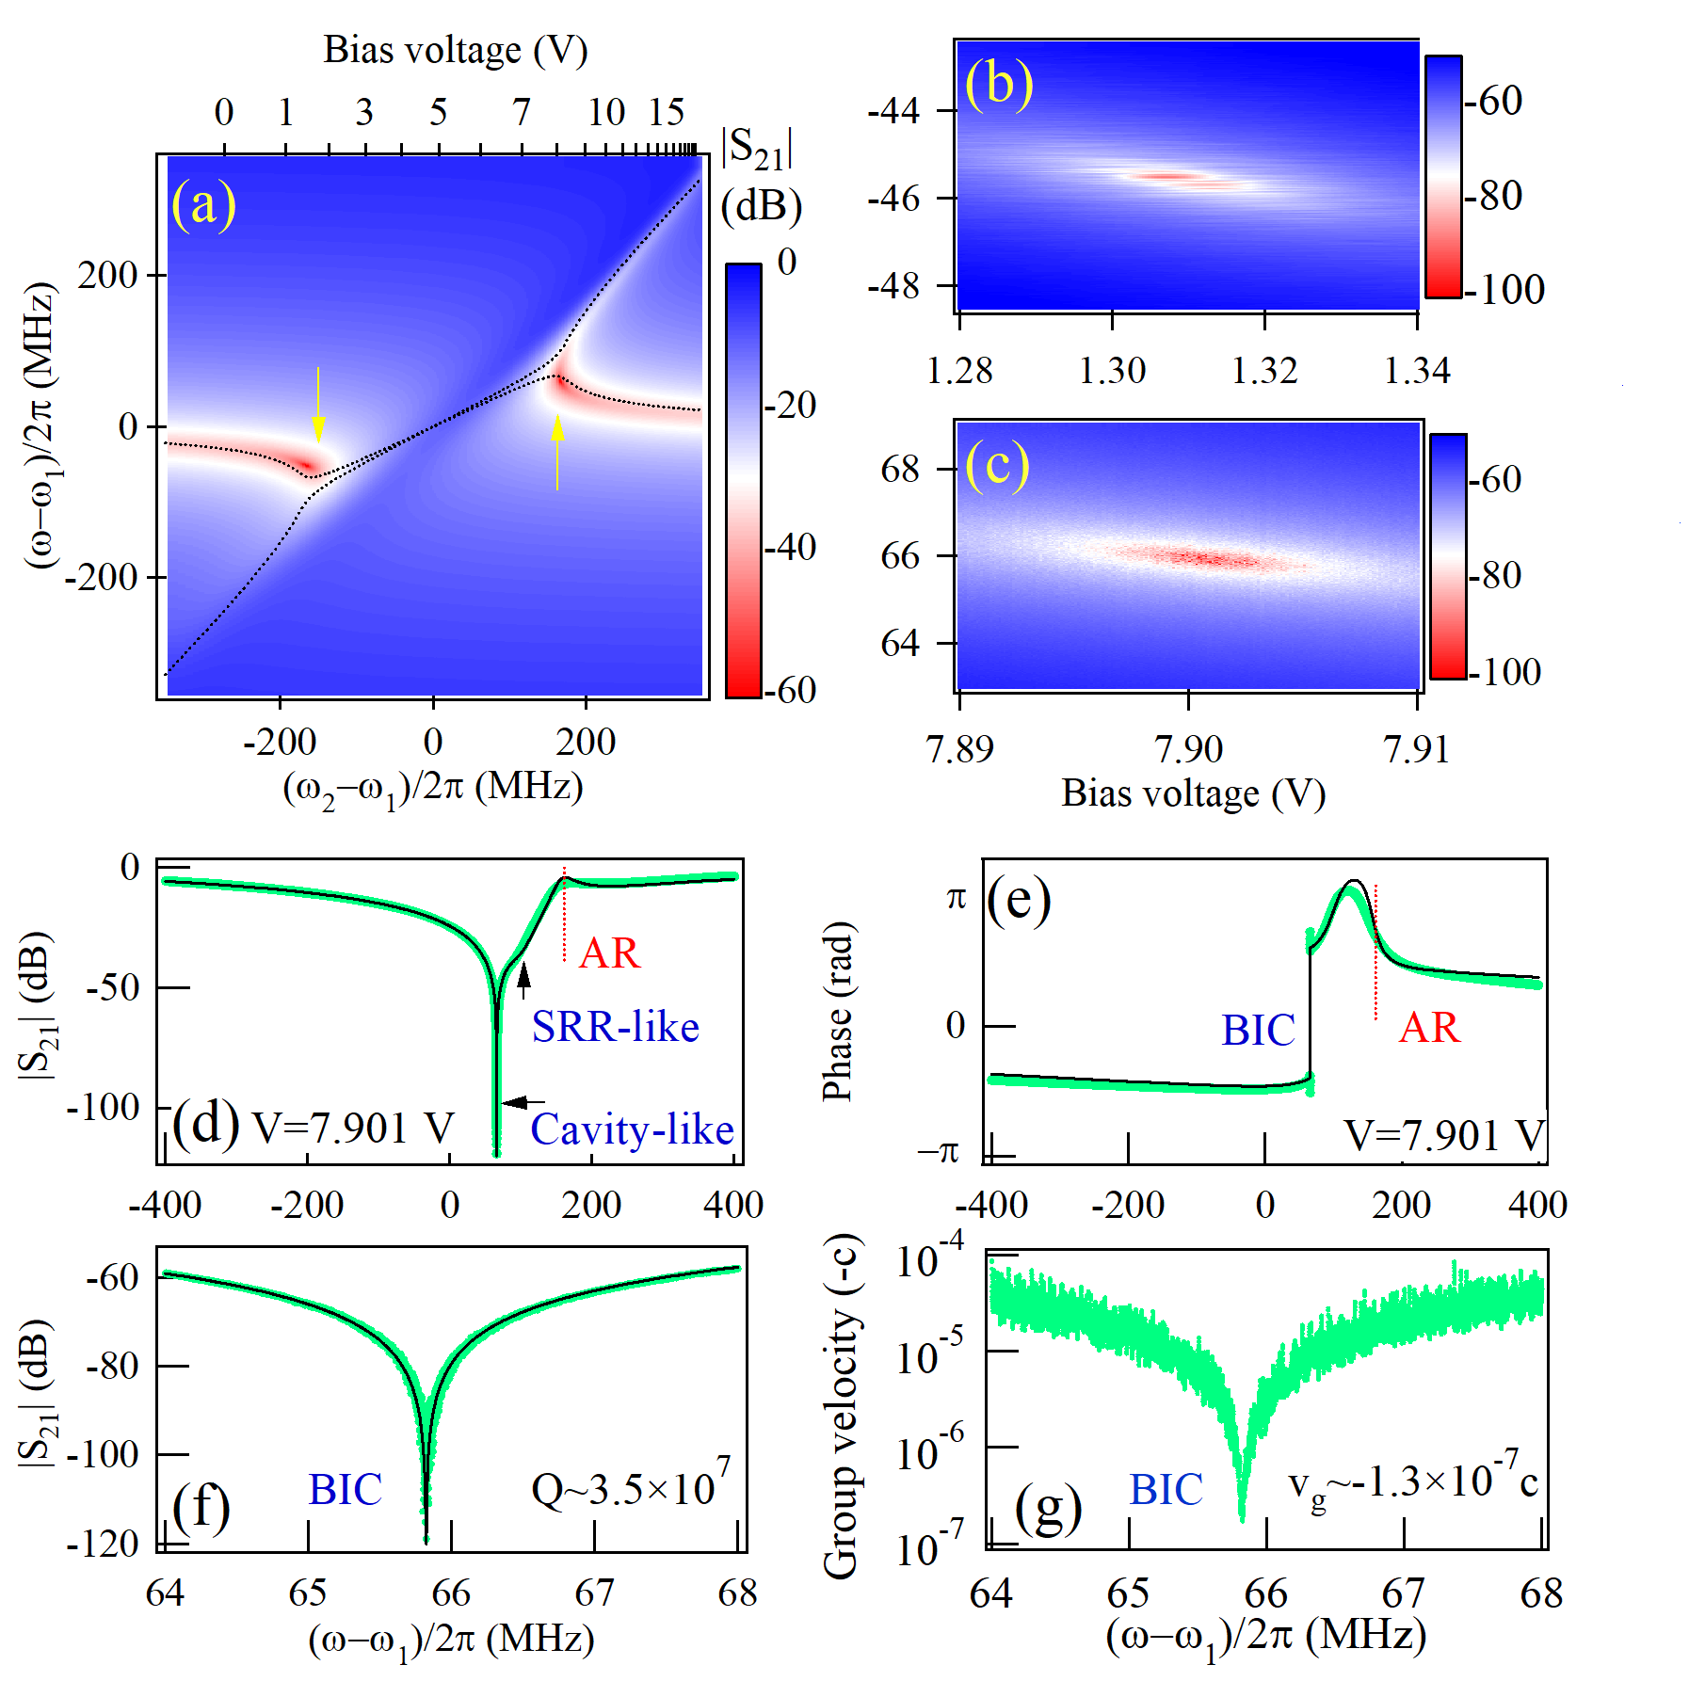
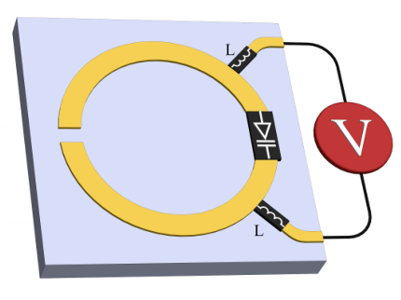


Voltage-controlled level attraction
Varactor loaded split-ring resonator
$$ω_{srr}=\frac{1}{\sqrt{LC }}$$
(b)
(c)
$Im\left(ω_{c}\right)=30 Hz$!
Ultra-high Quality factor → sensitive detection / sensor design
Notes:
In this work, we loaded a varactor onto the split-ring resonator. Since the resonant frequency are determined by the effective inductance and capacitance. We can use the varactor diode integrated on the split-ring resonator, and use a voltage source to control the capacitance, and therefore to vary the resonant frequency of the split-ring resonator.
By using this active tunable split ring resonator, we have realized the voltage controlled level attraction shown in figure (a).
The spectrum on black arrow was shown in figure (b). From figure (b), we can see the cavity like mode is a very sharp deep. If we zoom it in we can fit this mode linewidth see figure (c). The linewidth we fitted is only 30 Hz and corresponded to a quality factor over ten to the power of 7, which higher than 30 million compare to typical several hundred in traditional planar microstrip resonator.
Such high-quality factor bring a great improvement on frequency resolution and therefore offers a new approach to perform highly sensitive detection or design sensor.

Slide 13





Nonreciprocity in cavity magnon polariton
Wang, Yi-Pu, et al. "Nonreciprocity and unidirectional invisibility in cavity magnonics." Physical review letters 123.12 (2019): 127202.
$$S_{21}$$
$$S_{12}$$
Unidirectional transmission
Iso. (dB)= |S₂₁-S₁₂|
For Iso. >20db
Bandwidth ~ 0.5 MHz
~ magnon linewidth
Experiment Setup
Notes:
The nonreciprocal transmission is highly demand in quantum information procession. Especially for the quantum information storage unit – qubit. The qubits are very sensitive and even a small amount of back leakage would spoil its lifetime, and this would result the loss of quantum information. To overcome this unstable difficulties, we need the nonreciprocal device to read out the information from the qubit and at the mean time, protect the information in qubit from noisy environment.
The nonreciprocity, as the name suggests, is a signal can transmit from one way and blocked from the other way. Which is also known as the unidirectional transmission or unidirectional invisibility. In the previous work by Dr. Wang, they has discovered the nonreciprocal phenomenon by utilizing the dissipative coupling.
From figure we took from the paper, the transmission shows a nonreciprocal behavior in the blue region.
The experiment setup was given in left-bottom corner, we used a YIG sphere to be the magnon and the cross cavity to generate photon cavity. From experimental observation, the nonreciprocity only happens in a relatively narrow region. And if we take the nonreciprocity larger than 20db, we get the bandwidth is about half MHz, approximately equal to the magnon linewidth.
The narrow linewidth limits the application, therefore, to make it more practical, we need to extend its bandwidth.

Slide 14
Local control of magnon damping
Intrinsic damping
Radiation damping
Experiment Setup
External damping
Notes:
By doing so, we used a magnetic loop antenna to control the radiation of the magnon. The distance between the magnon and antenna can be varied by a step motor.
If we extract the spectrum and fitted by using Lorentzian function. We found the closer the magnetic loop, the larger magnon damping we have.

Slide 15


Broadband nonreciprocal device
Measured transmission
Measured nonreciprocity
Hundreds time of improvement!
Notes:
Now we put the damping tunable magnon into the system and measures the nonreciprocity.
The top left is we measured when the loop is close to the magnon and bottom left is when the loop is far away from the magnon. The transmission S21 peak moves apparently while the overall dispersion remains mostly same. The nonreciprocity changes as a function of distance shown on the top right which gives a tunable nonreciprocity over a large area. If we plot the tunable isolation rate as a function of operating frequency, we will have the figure shown on bottom right. This indicates that we have achieved the broadband nonreciprocal device with bandwidth of about 200 MHz, which is a few hundreds time of improvement if we compare to previous setup.
This work has been published on Physical Review Applied.

Slide 16
Summary of Contribution
We proposal a numerical method to analysis time-domain signal and have potential to study non-linear and chaotic effects in dissipative coupling.
Dissipatively coupled metamaterials for sensitive detectors, switching device.
Broadband nonreciprocal device by locally control magnon damping in CMP.
Notes:
In summary, there are three major contribution I have made. First is the theoretical part, I combined the ode solver and time domain analysis for the dissipative coupling.
Second is I have discovered the dissipative coupling in metamaterial sturctures and proofed it is capable of designing high-sensitive detectors and microwave switching devices.
And the third, I have achieved the broadband nonreciprocal device by locally control the magnon damping in cmp.
Several future work that maybe worthwhile to try.
1 …
2…

Slide 17

Additional Information for Clarification
Level attraction in Simulation
Magnetic Resonance of Split-ring Resonator
Classical circuit model for level attraction
Negative damping/resistance
Negative damping - coherent coupling calculation result
Negative damping - dissipative coupling calculation result
Relation between damping rates and quality factors
Linewidth evolution for dissipative coupling (negative damping)
Fano Resonance
Fano Resonance (2)
Fano Resonance for designing switching devices
Fano Resonance for designing sensors
Rabi Oscillation
Rabi oscillation for coherent coupling – time domain
Faraday Rotation
Why do people need nonreciprocal devices?
Between oscillators and polaritons
Damping control by Inverse-square law
Antiresonance
ODEs solvers for nonlinear / chaotic analysis (1-3)

Slide 18



Level attraction in Simulation

Slide 19
Level attraction in Simulation (2)

Slide 20

Magnetic Resonance of Split-ring Resonator
Three ways to excite resonance of an SRR.
(i) Electric coupling to magnetic resonance
(ii) Magnetic coupling to magnetic resonance
(iii) Electric coupling to electric resonance
+ (ii) → magnetic dipole in z-direction
(iii) → electric dipole in y-direction

Slide 21

Classical circuit model for level attraction
Impedance Z → transmission matrix (ABCD) → Scattering matrix (S₂₁ & S₁₁)
Equivalent to
Hamiltonian model
Two classical RLC oscillator coupled with a transmission line.
This model confirms the importance of travelling wave in this system.

Slide 22





Negative damping/resistance
$ω_{1}=1/\sqrt{LC}$ $\text{– }\text{resonance} \text{frequency}$
$κ=Z_{0}/4L$– external damping
$γ=R/2L$– intrinsic damping
Single RLC resonator in a Two-port Network
Amplitude
Phase
Complex plane
Zero damping
Positive damping
Negative damping

Slide 23

Negative damping/resistance (2)
Coherent coupling case
The S21 trajectory always exclude origin, showing the damping is always positive

Slide 24

Negative damping/resistance (3)
Dissipative coupling case
The S21 trajectory sometimes include origin, showing the damping could be zero/negative!
Zero damping
Negative damping
Zero damping

Slide 25




Relation between damping rates and quality factors
External Q factor → intrinsic + external damping
Unloaded Q factor → intrinsic damping $∝$ R
Loaded Q factor → external damping
$$Q=\frac{ω_{1}}{Δω}$$
Khanna, A. P. S., and Y. Garault. IEEE Transactions on Microwave Theory and Techniques 31.3 (1983): 261-264.

Slide 26

Linewidth evolution for dissipative coupling
Linewidth evolution
Taking phase
into consideration

Slide 27



Fano Resonance
In 1961, Ugo Fano discovered a distinctly asymmetric shape while studying the autoionizing states of atoms.
Characteristic : One discrete state and one continuum
In our case:
travelling wave → continuum states
SRR → discrete state
Yao, Bimu, et al. "The microscopic origin of magnon-photon level attraction by traveling waves: Theory and experiment." Physical Review B 100.21 (2019): 214426.
Fano, Ugo. "Effects of configuration interaction on intensities and phase shifts."
Physical Review 124.6 (1961): 1866.

Slide 28

Fano Resonance (2)
Miroshnichenko, Andrey E., Sergej Flach, and Yuri S. Kivshar.
"Fano resonances in nanoscale structures." Reviews of Modern Physics 82.3 (2010): 2257.
“ Such waveguide-cavity systems can naturally exhibit Fano resonances with high quality factors, and they can be used for optical modulations and switching. ”
“ Therefore, the Fano resonance can be considered as a precursor of BICs, with unique properties that may lead to applications including optical sensors, filters and waveguides, as well as low-loss fibres and large-area lasers. ”

Slide 29



Fano Resonance for designing switching devices
ON
OFF
Yanik, Mehmet Fatih, Shanhui Fan, and Marin Soljačić. "High-contrast all-optical bistable switching in photonic crystal microcavities." Applied Physics Letters 83.14 (2003): 2739-2741.
Nozaki, Kengo, et al. "Ultralow-energy and high-contrast all-optical switch involving Fano resonance based on coupled photonic crystal nanocavities." Optics express 21.10 (2013): 11877-11888.

Slide 30






Fano Resonance for designing sensors
Yellow material:
Dielectric material under test
Sensor design
Fano resonance spectrum
Frequency shift
Sensitivity
Hao, Feng, et al. "Symmetry breaking in plasmonic nanocavities: subradiant LSPR sensing and a tunable Fano resonance." Nano letters 8.11 (2008): 3983-3988.
Singh, Ranjan, et al. "Ultrasensitive terahertz sensing with high-Q Fano resonances in metasurfaces." Applied Physics Letters 105.17 (2014): 171101.

Slide 31



Rabi Oscillation
A Rabi oscillation is a damped oscillation of an initially excited atom coupled to an electromagnetic resonator or cavity. In this process, atom alternately emits photons into a single-mode electromagnetic cavity and reabsorbs them.
$$Ω_{R}$$
Excited state 1
(cavity)
Excited state 2
(atom/magnon)
Ground state
Schematic for a two-level system
Typical frequency-domain observation

Slide 32


Rabi oscillation for coherent coupling – time domain
Zhang, Xufeng, et al. "Strongly coupled magnons and cavity microwave photons." Physical review letters 113.15 (2014): 156401.
Match, Christophe, et al. "Transient response of the cavity magnon-polariton." Physical Review B 99.13 (2019): 134445.

Slide 33


Slide 34

Faraday Rotation
The Faraday effect causes a rotation of the plane of polarization which is linearly proportional to the component of the magnetic field in the direction of propagation.
Non-reciprocity can be generated by inserting a polarizer.
Kamal, Archana, John Clarke, and M. H. Devoret. "Noiseless non-reciprocity in a parametric active device." Nature Physics 7.4 (2011): 311-315.

Slide 35


Why do people need nonreciprocal devices?
invisible sensing or cloaking
noise-free information processing
qubit shield / protection
Other circuit design
Optical invisibility of a human hand
He, Cheng, et al. "One-way cloak based on nonreciprocal photonic crystal." Applied Physics Letters 99.15 (2011): 151112.
UNSW Sydney, Griffith University
Shielding qubits from environmental noise
Sounas, Dimitrios L., and Andrea Alù. "Non-reciprocal photonics based on time modulation." Nature Photonics 11.12 (2017): 774-783.

Slide 36


Between oscillators and polaritons
Simplified model to explain the behavior of polariton and pendulums
$\left[\begin{matrix}ω−{\tilde{ω}}_{1}−iΓ & iΓ \\ iΓ & ω−{\tilde{ω}}_{2}−iΓ\end{matrix}\right]\left[\begin{matrix}|φ_{1}| \\ |φ_{2}|\end{matrix}\right]$ = $\left[\begin{matrix}0 \\ 0\end{matrix}\right]$
$\left[\begin{matrix}ω−{\tilde{ω}}_{1} & iΓ \\ iΓ & ω−{\tilde{ω}}_{2}\end{matrix}\right]\left[\begin{matrix}|φ_{1}| \\ |φ_{2}|\end{matrix}\right]$ = $\left[\begin{matrix}0 \\ 0\end{matrix}\right]$
Mechanical oscillators
Polaritons
Mechanical systems
Polariton systems

Slide 37

Damping control by Inverse-square law
Suppose the magnetic loop antenna introduce an anisotropic environment with certain area around magnon.
This area influence the environment would decay with the inverse-square law

Slide 38




Calculation parameter for ODEs solvers
Coherent coupling - Rabi Oscillation like
$$J=0.5 Hz$$
$$ω_{1}=ω_{2}=10 Hz$$
Dissipative coupling - Synchronization like
$$Δω_{1}=Δω_{2}=0.01 Hz$$
$$Γ=0.5 Hz$$

Slide 39


Antiresonance
Directly coupled resonator
Side coupled resonator
Resonance
Anti-Resonance
Resonance
Antiresonance
Journal of Electrical Engineering & Technology 12.2 (2017): 846-851.
→ Minimum response to external driving

Slide 40


Antiresonance (2) video demonstration
Minimum response to external driving

Slide 41

Modulation depth
A relative modulation amplitude, or the maximum change in transmission.

Slide 42


Switching window
The frequency window between the transmission 1 to zero
Application: Ultrafast switch
Srivastava, Yogesh Kumar, et al. "A Superconducting Dual‐Channel Photonic Switch." Advanced materials 30.29 (2018): 1801257.

Slide 43

ODEs solvers for nonlinear / chaotic analysis (1)
For a linear oscillator with driving force, we can calculate the trajectory.
Stable point

Slide 44

ODEs solvers for nonlinear / chaotic analysis (2)
For a nonlinear oscillator with driving force, we can calculate the trajectory.
Stable point

Slide 45


ODEs solvers for nonlinear / chaotic analysis (1)
For a chaotic oscillator with driving force, we can calculate the trajectory that depends on initial conditions.

